Slide 1
Protecting Your Hives From Bears and Other Predators
Huguenot Beekeepers Association
Greg Gibson
April 6, 2017

Slide 2
Why Are We Talking About This?
Three club members have reported a bear damaging or destroying their hive(s) in the last few weeks.
Bears have been spotted destroying bird feeders and other backyard “food sources” all throughout Powhatan recently.
Bears are attracted not just to honey, but also frames of brood (pupae, larvae, and eggs) which provide fat and protein.
An ounce of prevention is worth a pound of cure!

Slide 3
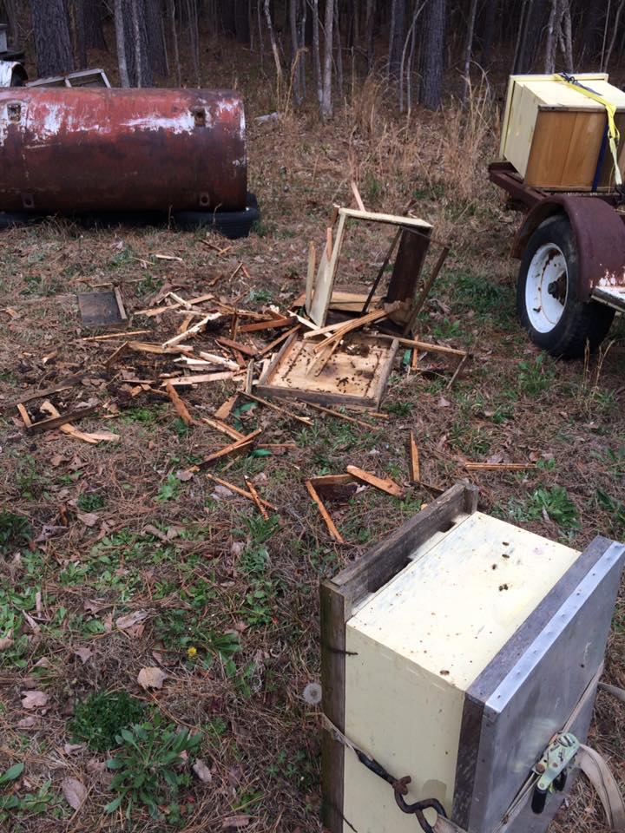
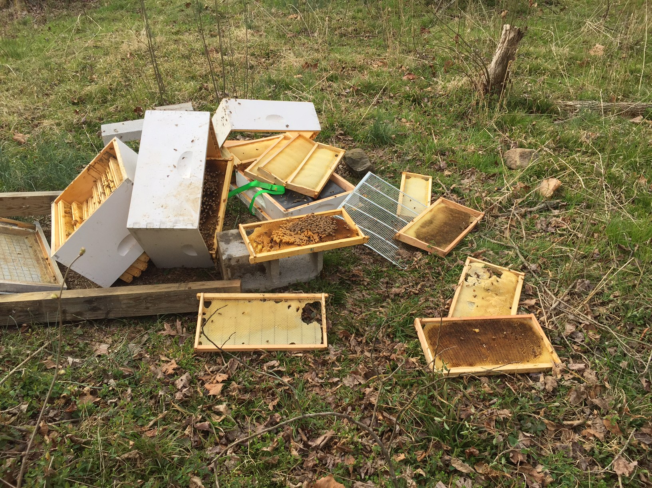
Why Are We Talking About This?

Slide 4
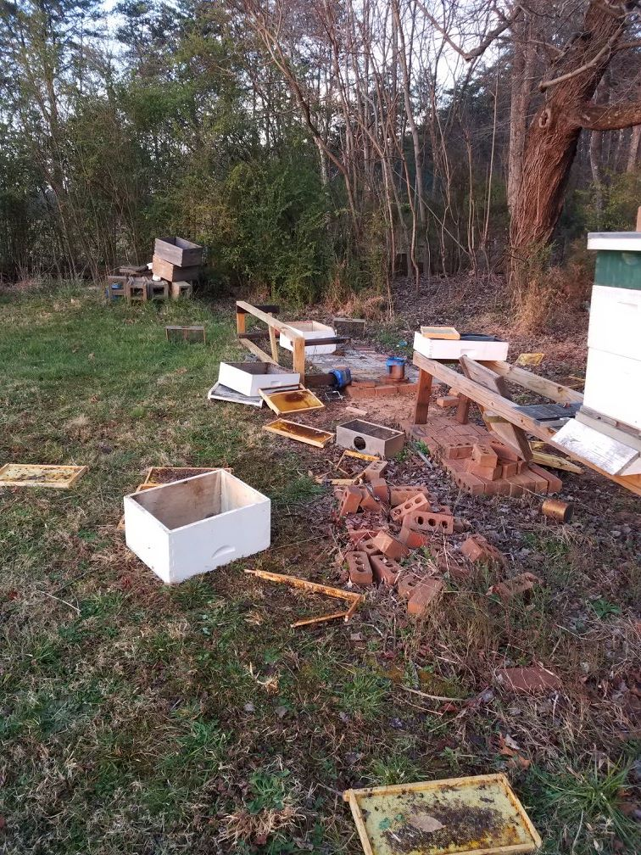
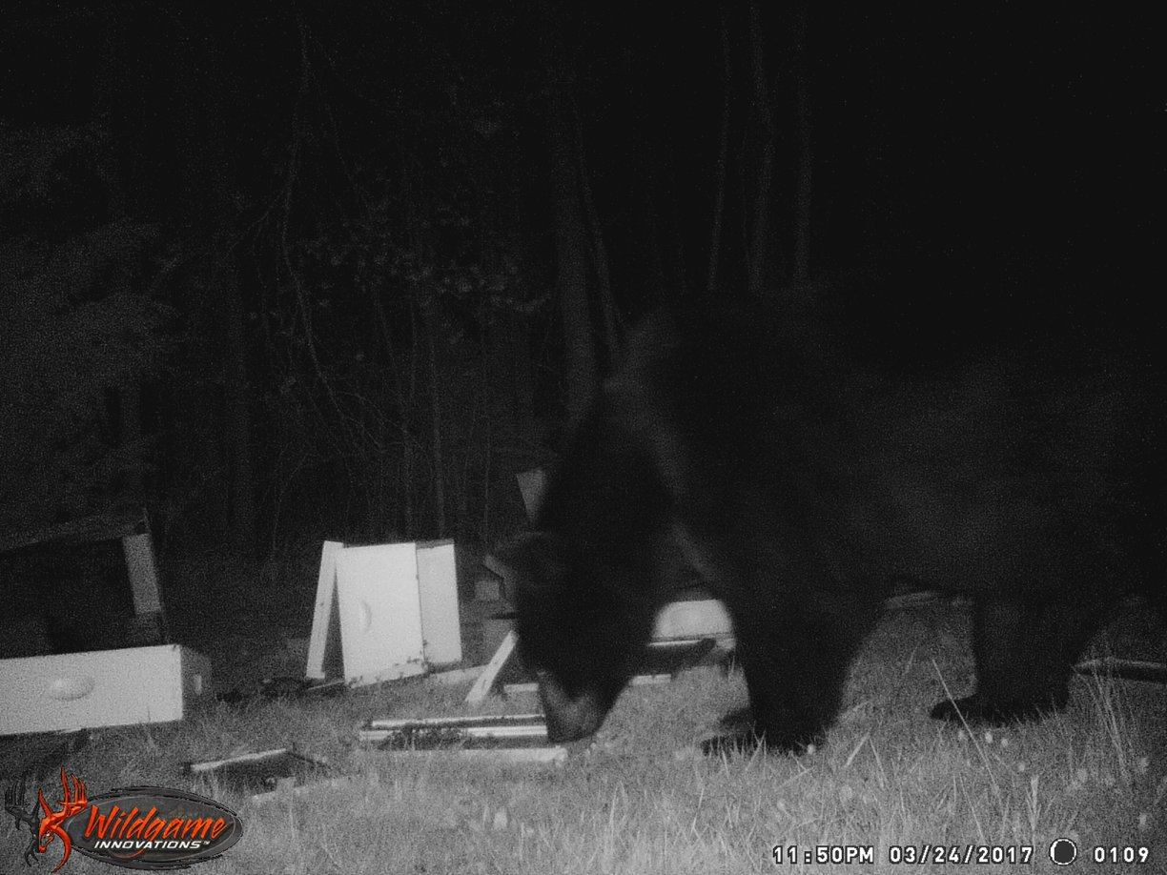
Why Are We Talking About This?

Slide 5
Installing an Electric Fence
Materials List
Charger – Electric or Solar depending on power availability, Low Impedance.
Grounding System: 90% of electric fence problems can be traced back to the fence being improperly grounded.
Grounding Rods – Recommend Three 6’ Copper Rods 10 feet apart. Galvanized is cheaper but less effective.
Grounding Rod Clamps – MUST bite into the rod.
Insulated Grounding Wire.
Wire – 12-16 gauge for Bears.
Posts – wood, fiberglass, t-posts, etc – Corners should be sturdy enough to hold the tension but the line posts are there just to hold the wire up.
Insulators – attach the wire to the post while preventing it from touching the post (creating an errant ground).
Gate kit – handle and anchor for each wire.
Connectors – connecting charger to the fence.
Wire strainers / tensioners

Slide 6
Installing an Electric Fence
Installation Steps
Lay the posts out with emphasis on positioning corners and your gate area.
Drive and anchor the corner posts.
Install your charger with consideration for closeness to the fence, grounding system, and the path of the sun (if solar).
Install your grounding system – take your time and get it right!
Run the BOTTOM wire first, from corner to corner and apply SLIGHT tension.
The purpose of the tension is to make the wire straight / prevent sag.
Install line posts as needed using the bottom wire as a guide.
Install remaining wires and gate using the diagrams on the next slides.
Connect the charger to the fence and ground.
***BAIT the fence*** using strips of aluminum foil smeared with peanut butter. This will ensure the bear learns to respect the fence without charging through.

Slide 7
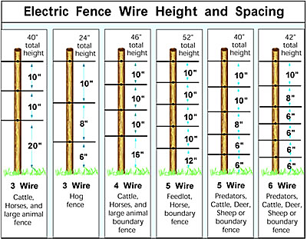
Installing an Electric Fence

Slide 8
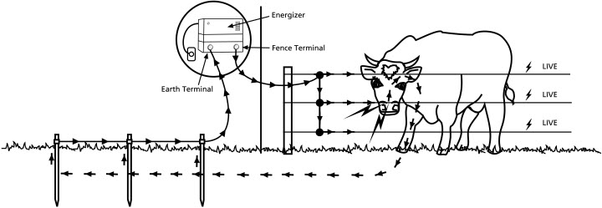
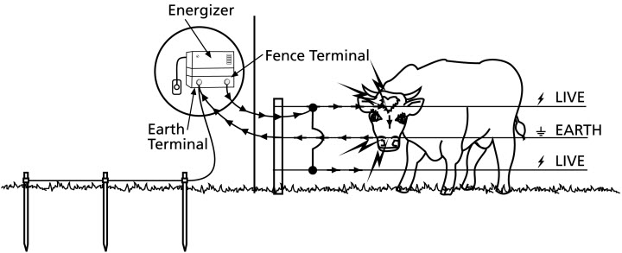
Installing an Electric Fence
Every Wire Hot:
Ensures contact with ANY wire can result in a shock.
Requires conductive earth – grassy, moist soil is best
Alternate Ground:
Contact with a hot wire OR a hot and ground wire can result in a shock.
Contact with ONLY ground will NOT result in shock.
Required with dry / sandy soils.

Slide 9
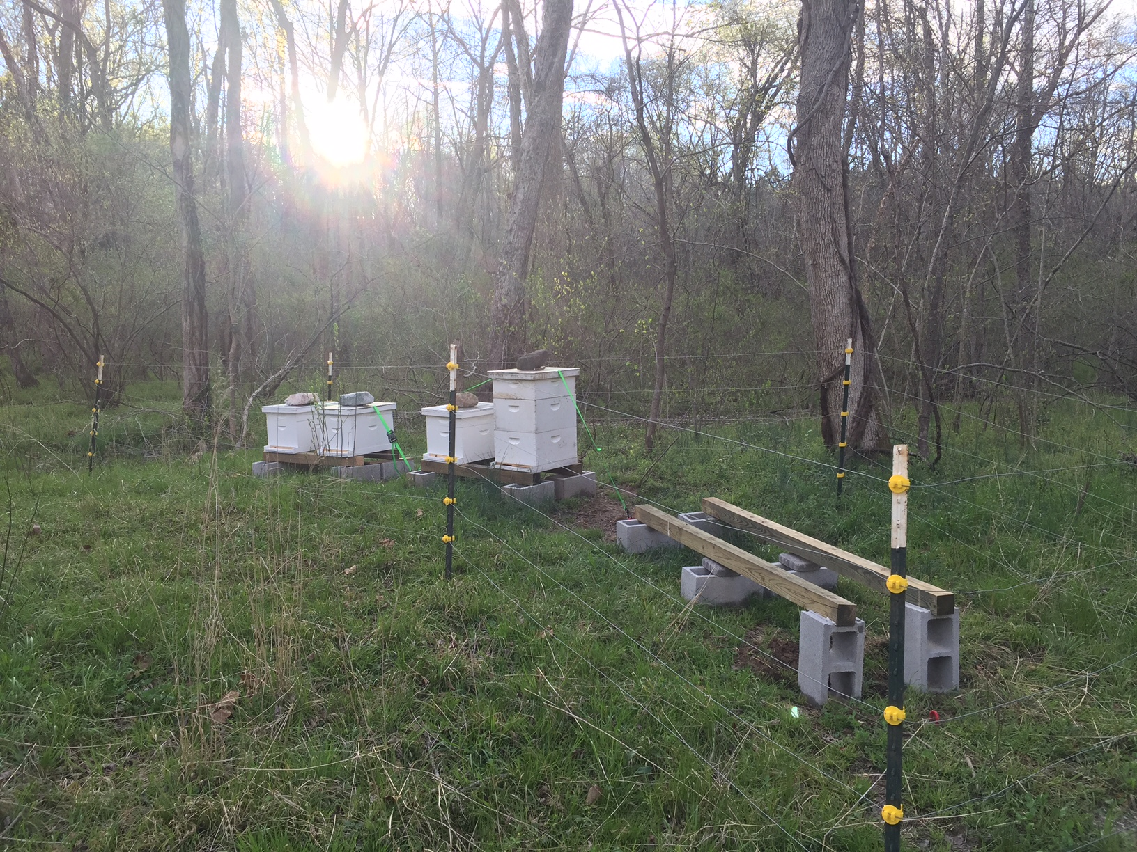
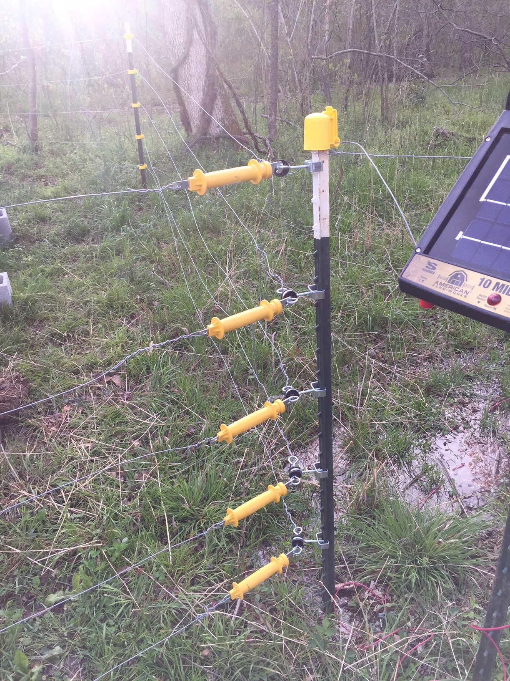
Installing an Electric Fence

Slide 10
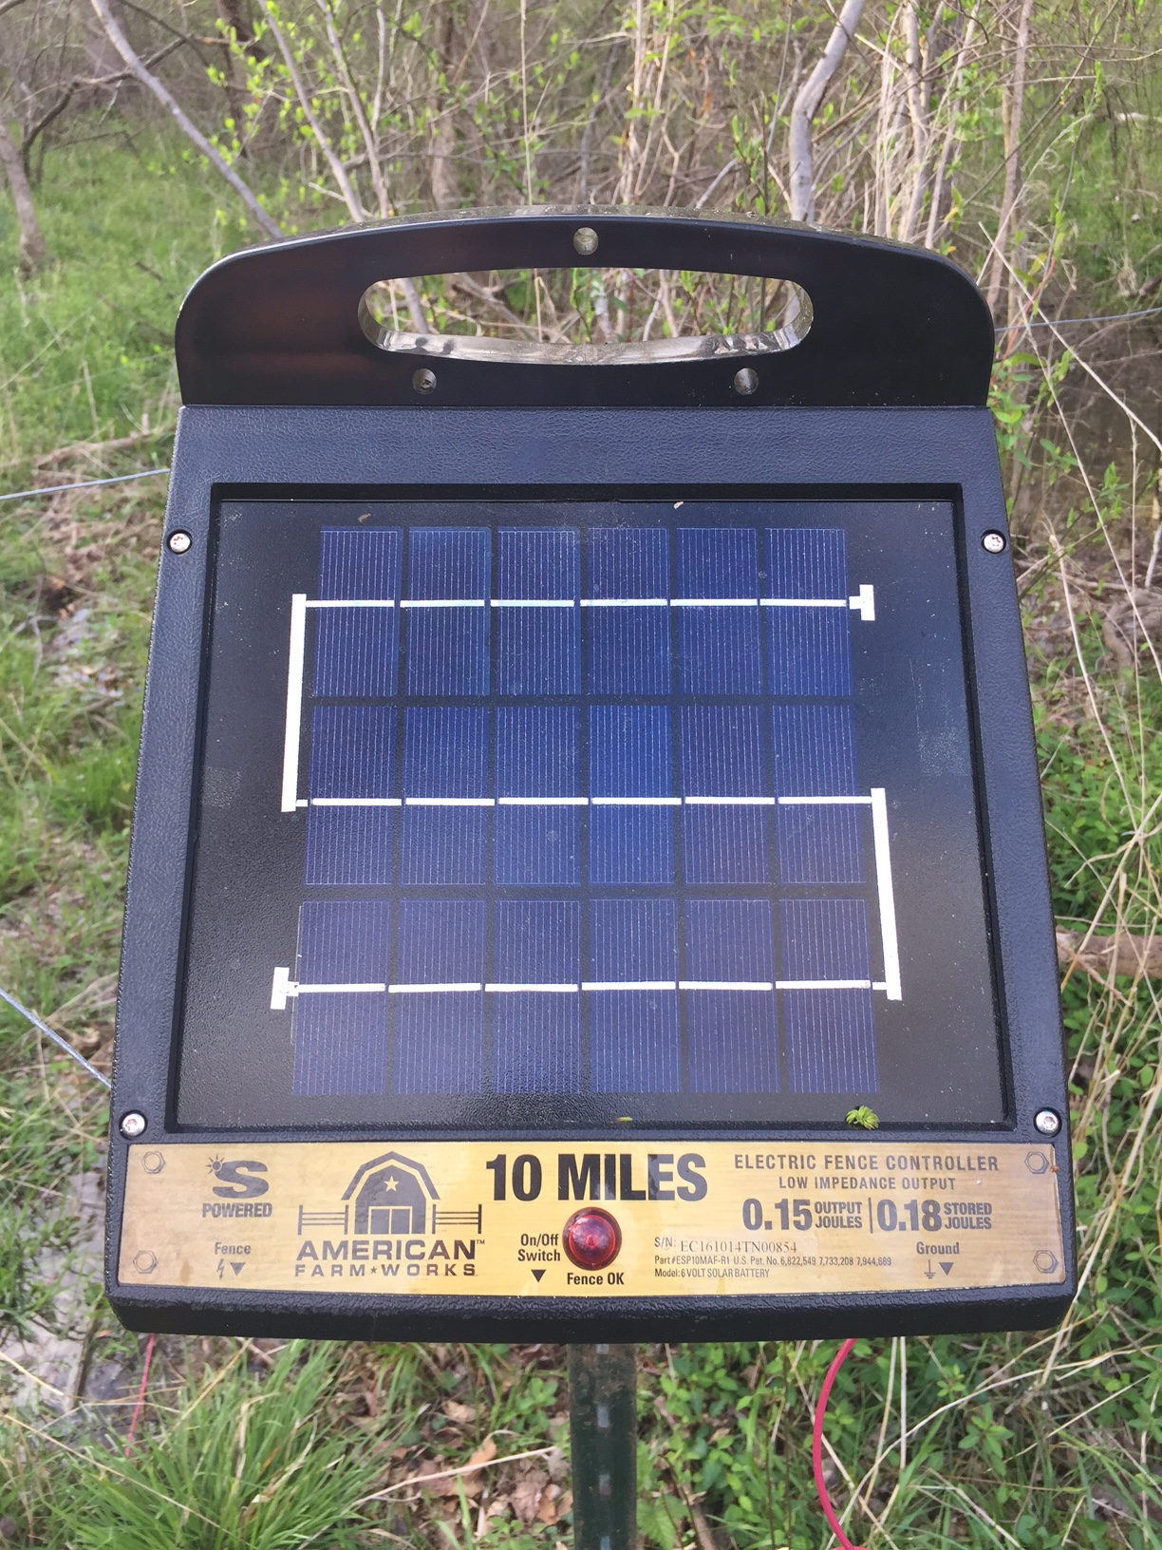
Installing an Electric Fence

Slide 11
Installing an Electric Fence
DO buy the biggest shock you can afford - Bears have very thick skin / fur.
DO place warning signs around the fence indicating the potential for shock.
DO keep the grass, weeds, and brush regularly maintained – contact with the fence can ground the system, lowering the effectiveness.
DO install the ground rods in moist soil - this improves the effectiveness of the grounding system.
DO setup the fence BEFORE predators find your hives. Solar chargers take up to 3 days in direct sunlight before they are ready for use.
DO use a trail cam to capture evidence.

Slide 12
Installing an Electric Fence
DON’T place posts too close together – for a small apiary they can be 8-10’ apart.
DON’T place the fence too close to your hives – leave at least 3-5’ of space for room to work.
DON’T skimp on the grounding – Three 6’ rods spaced 10’ apart.
DON’T overtighten the wire – the point of the fence is to deliver a shock, NOT be a physical barrier.
DON’T use barbed wire – animals (and humans) can become entangled in the fence and receive a continuous shock.

Slide 13
Resources
Virginia Department of Game and Inland Fisheries
https://www.dgif.virginia.gov/wildlife/bear/
VDGIF – Electric Fencing for Bears
https://www.dgif.virginia.gov/wp-content/uploads/fencing.pdf
Vermont Bearhound Association – Bearproofing Beehives
http://vermontbeekeepers.org/images/pdf/Bearproofing_Booklet%20PDF.pdf

